Slide 1
Sports Analytics
UNCC FOOTBALL
Dr. John Tobias
Sports Analytics Program Director
UNC Charlotte
Akhilesh Pothuri
DSBA 6400
UNC Charlotte
Coach Biff Poggi
UNC Charlotte

Slide 2
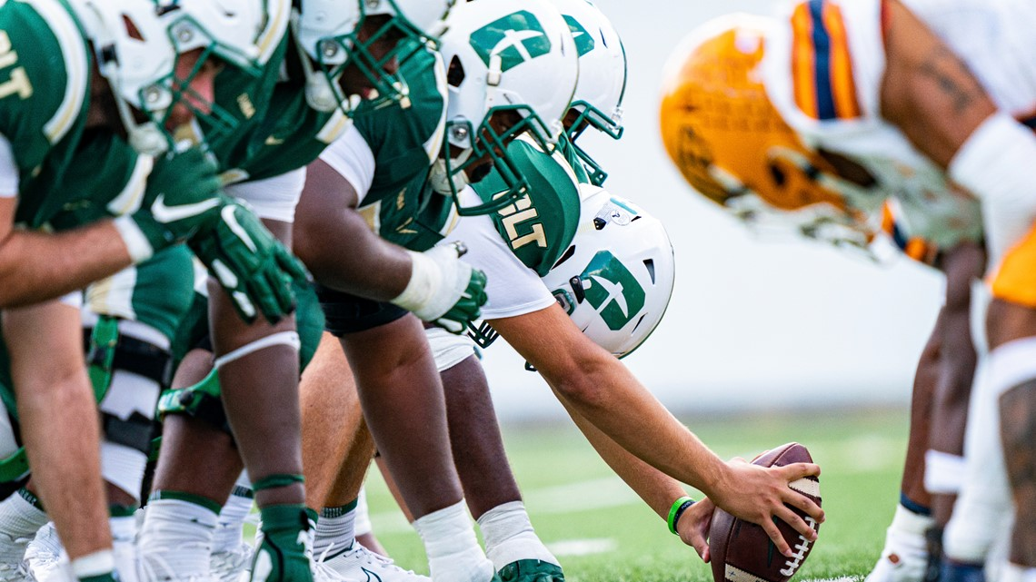
Objective and Goals
The objective of this project is to study how the UNC Charlotte football players perform during games and provide live statistics. We also want to help the coaches with their game strategies and building a strong team.
To predict ‘Gain’ allowed by our Defense team based on formations, field positions etc.
Predict Run/Pass play to help coaches with defensive strategies.
Build a CNN Model to automate the manual live tracking process.

Slide 3
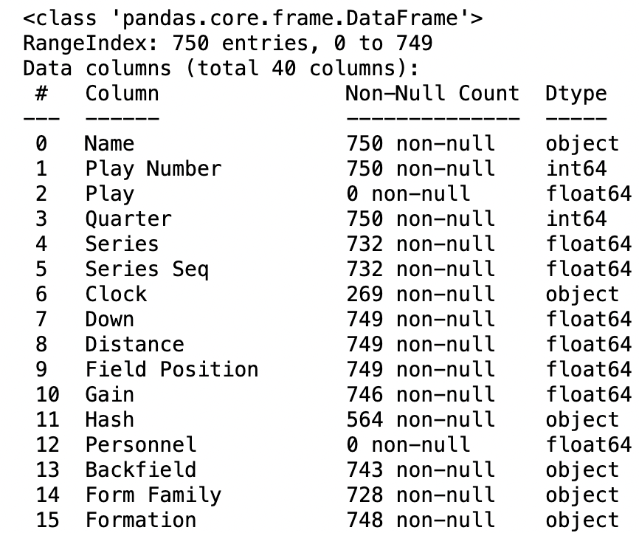
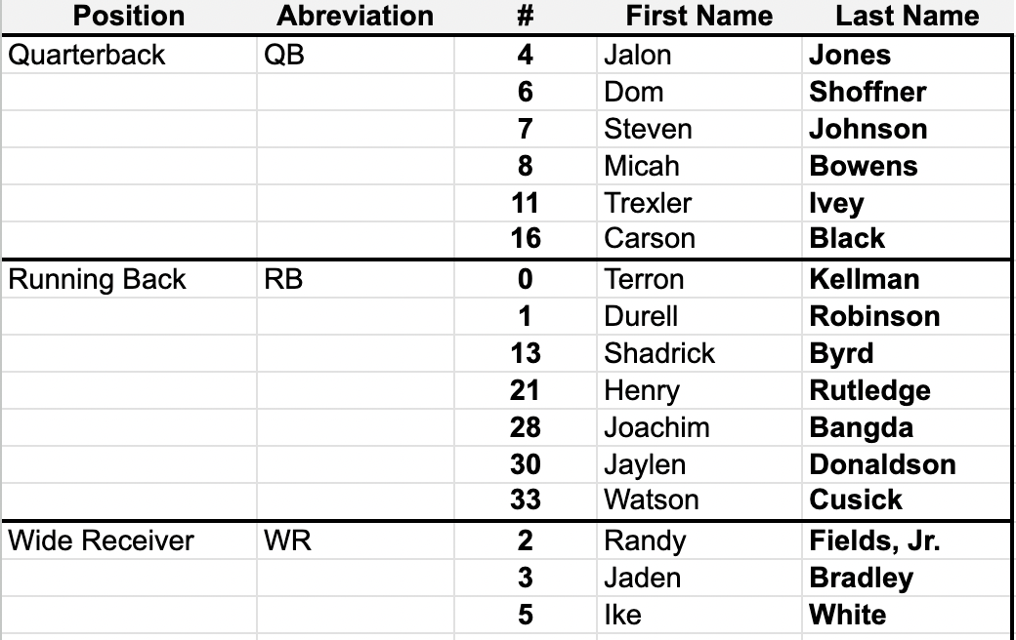
How is the Data?
Datasets Used
Catapault : Comprised of Fall 2023 Season ( 750 rows, 40 features)
Player Information : Player Name, Offense/Defense, Player Position, Jersey Number
NFL labelled dataset (Video Footages)
We manually collected all the data possible by attending the matches live and calculated required fields like Down and Distance using video footages.

Slide 4
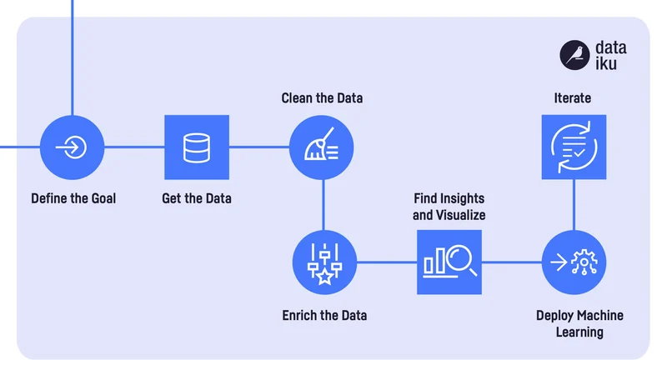
Plan of Execution

Slide 5
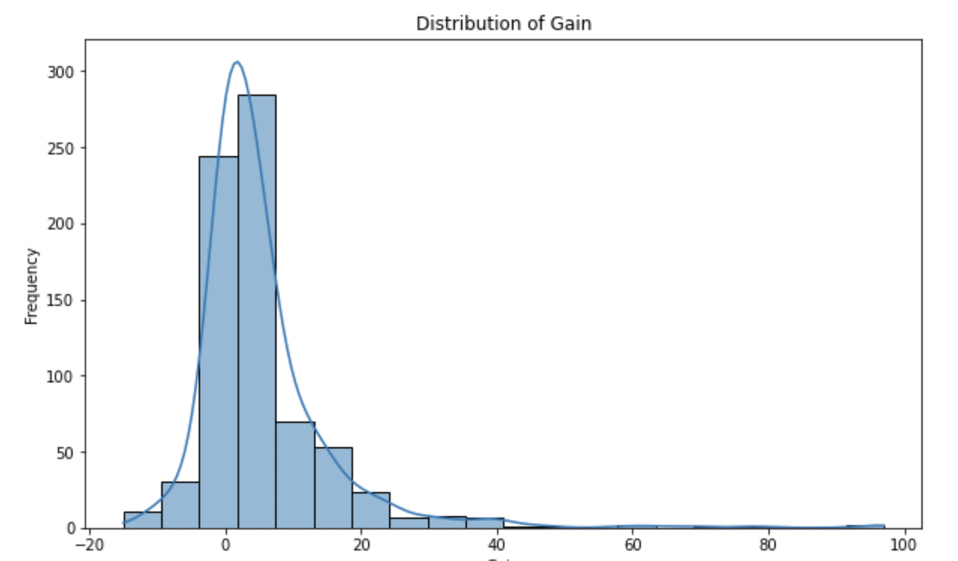
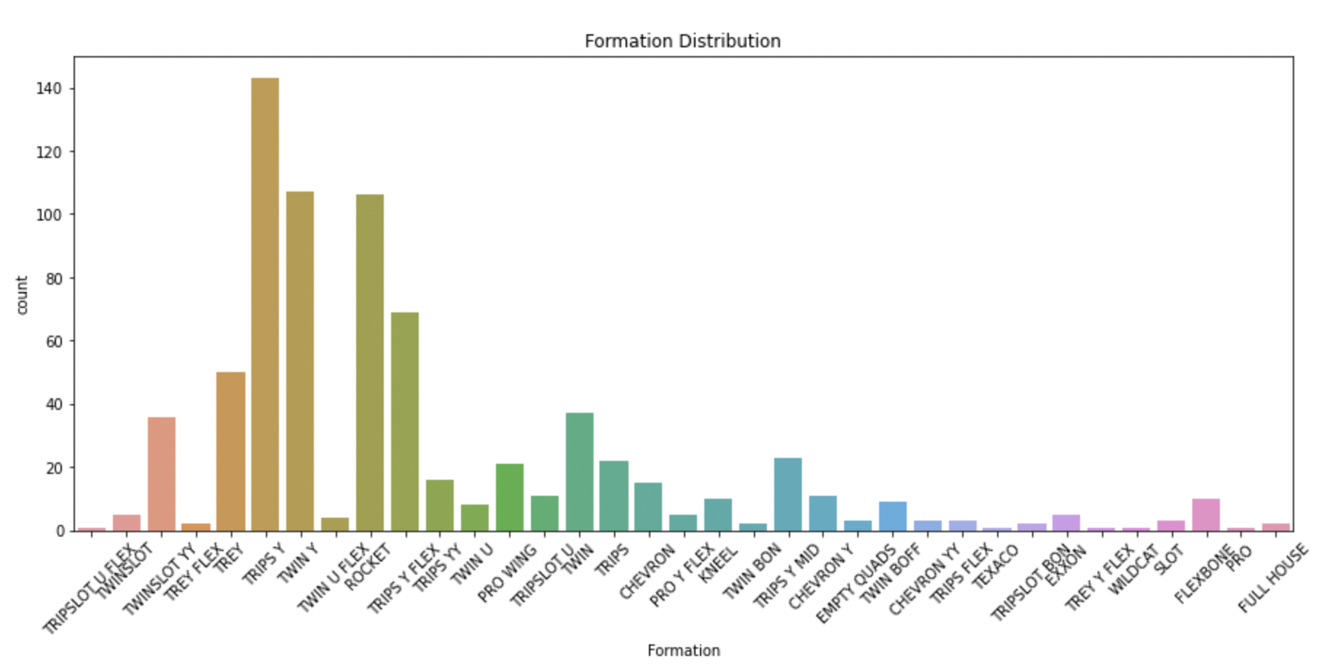
Glance into the Data
Distribution of Gain across all the plays
Frequency of formations followed by the team

Slide 6
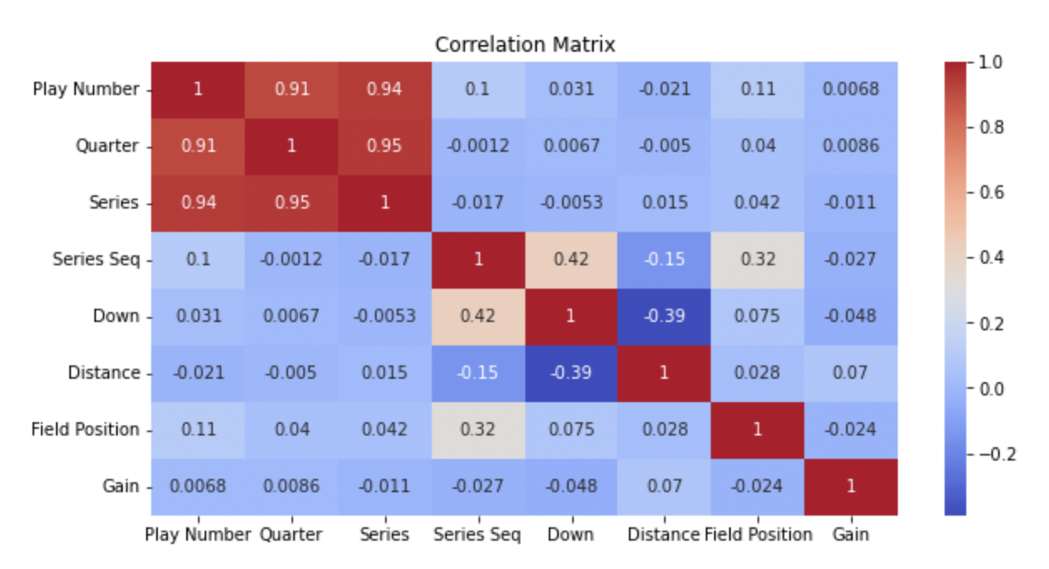
Data Cleaning
Feature Engineering
Imputing Missing Values
Drop Duplicates
Correct Human Errors
One-Hot Encoding
Multicollinearity using VIF

Slide 7
MODELLING
Gain Prediction
Random Forests
SVR
Linear Regression
Gradient Boosting Regressor
R/P Classification
Random Forests
SVC
Gradient Boosting Classifier
Jersey Number Detection
EfficientNet

Slide 8
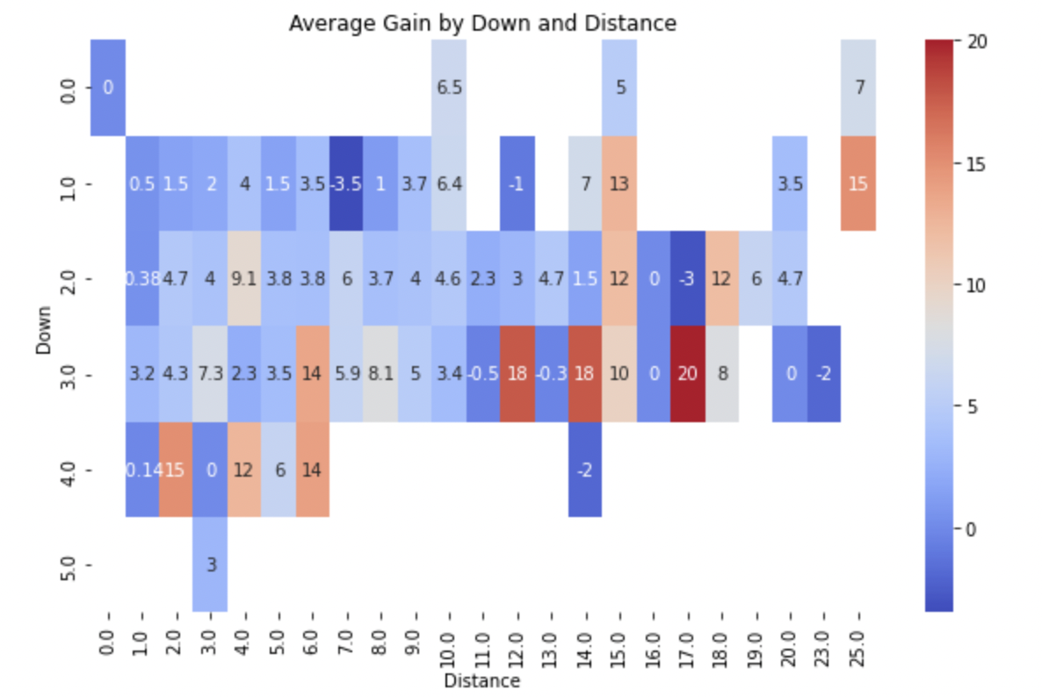
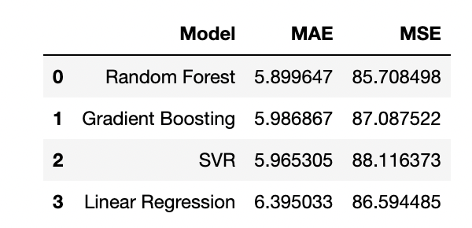
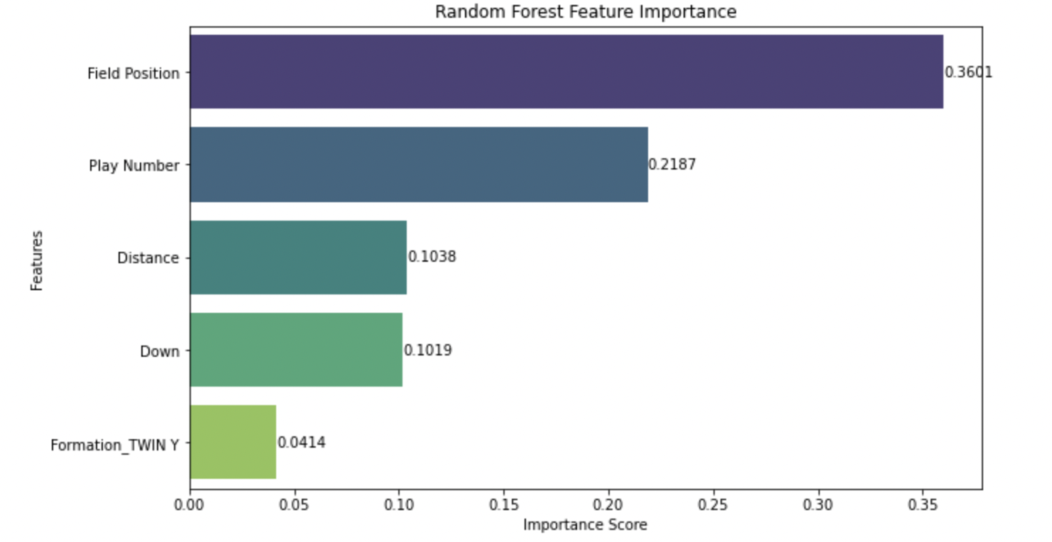
Gain Models Performance
Features used: [‘Name’, 'Play Number', 'Down' ,'Distance', 'Field Position', 'Formation', 'Backfield']

Slide 9
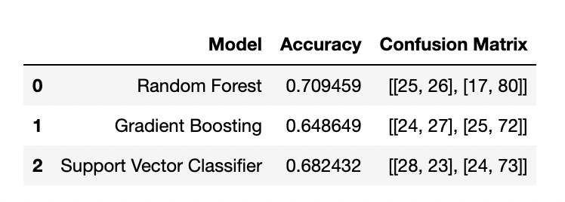
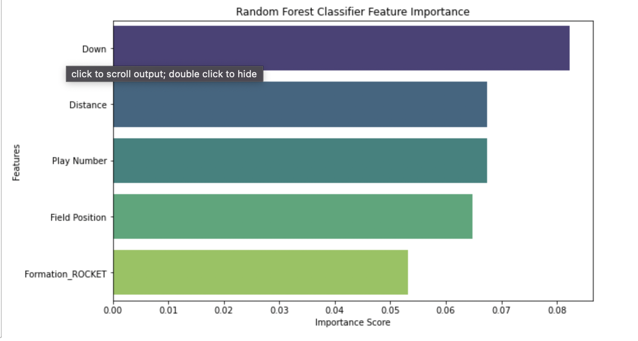
R/P Classification Models Performance
Features used: [‘Name’, 'Play Number', 'Down' ,'Distance', 'Field Position', 'Formation', 'Backfield']

Slide 10
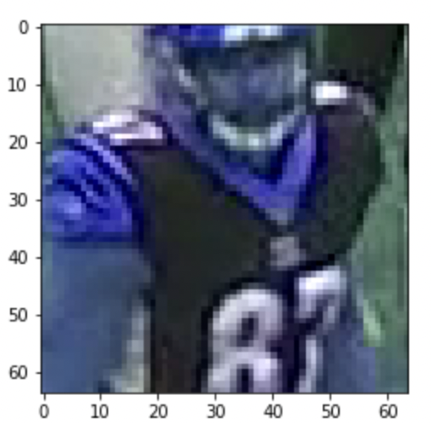
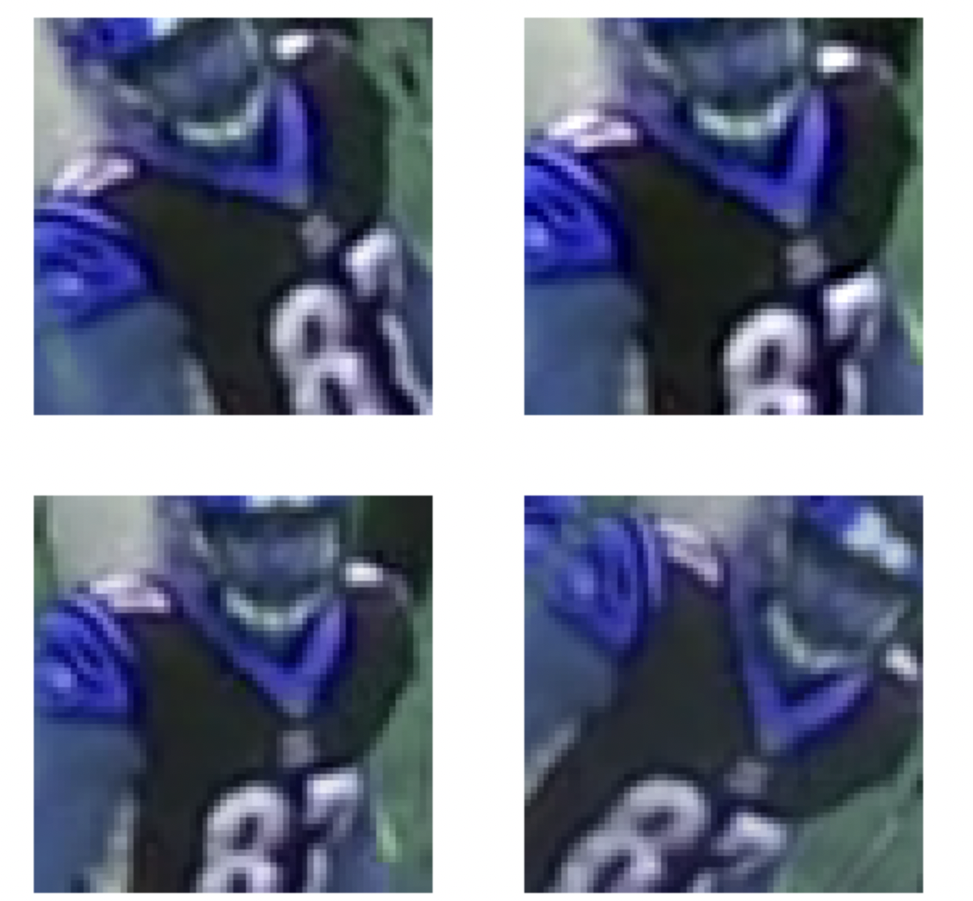
Jersey Number Detection
Input - .mp4 Video Footage
We use the helmet boxes positions provided in the dataset to identify and detect player jersey numbers.
We use a Sequential Model for Data Augmentation ( Rotation, Zoom, Contrast)

Slide 11
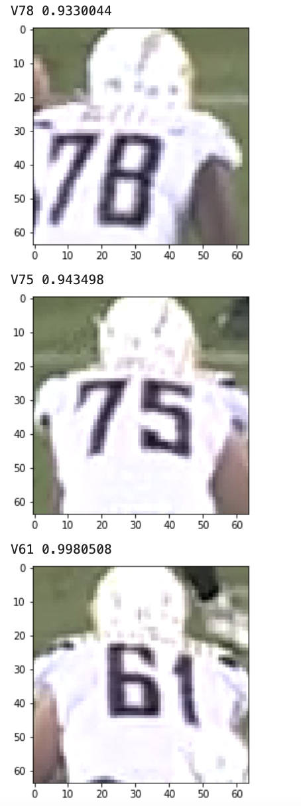
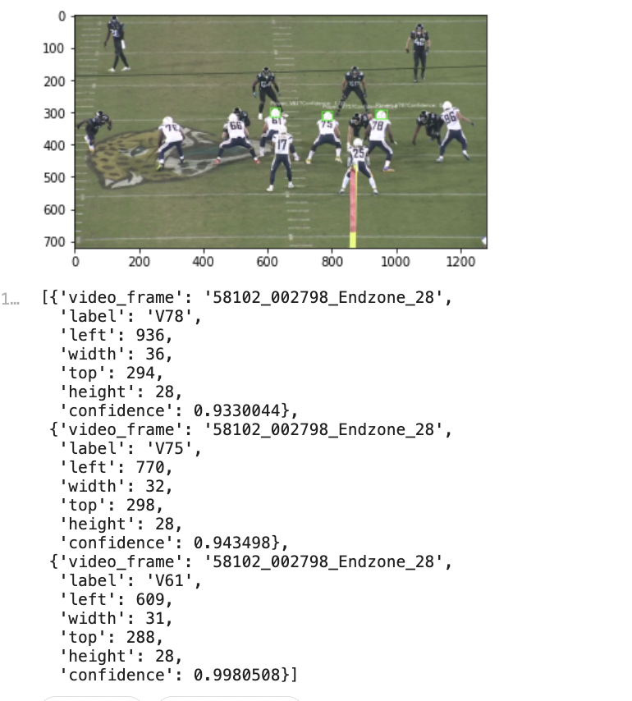
Model Performance
Individual Frames
Final Output
Play Footage
Training Accuracy : 89.44%
Validation Accuracy: 65.14%

Slide 12

What Next?
Inclusion of Historical Seasons information would further boost the analysis.
Deploy Jersey Number Detection to work real-time.

Slide 13
Questions?

